Slide 1
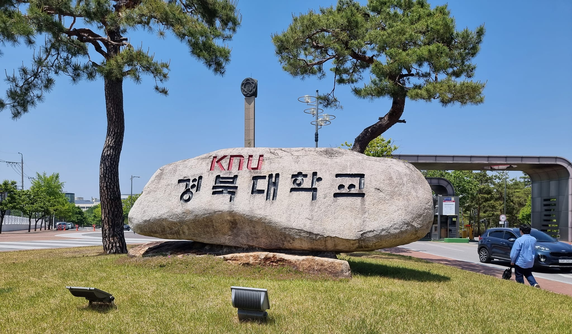
컴퓨팅사고와 SW코딩 3rd week
안병준 coolbrise@knu.ac.kr

Slide 2
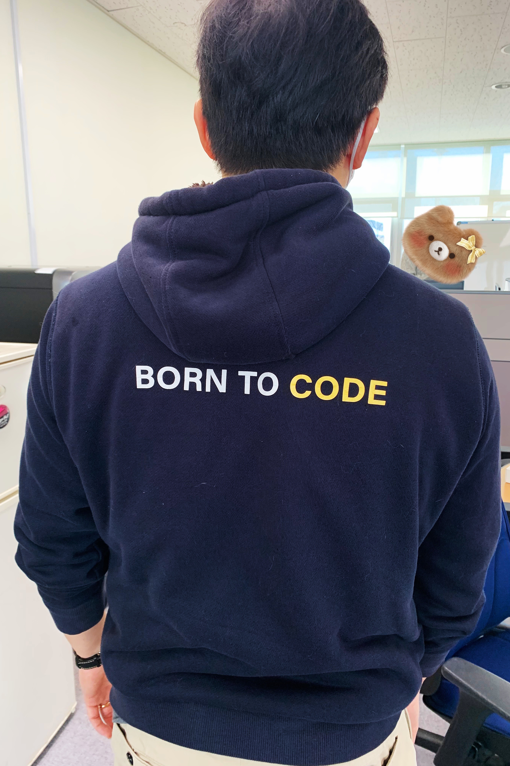
Born to Code

Slide 3
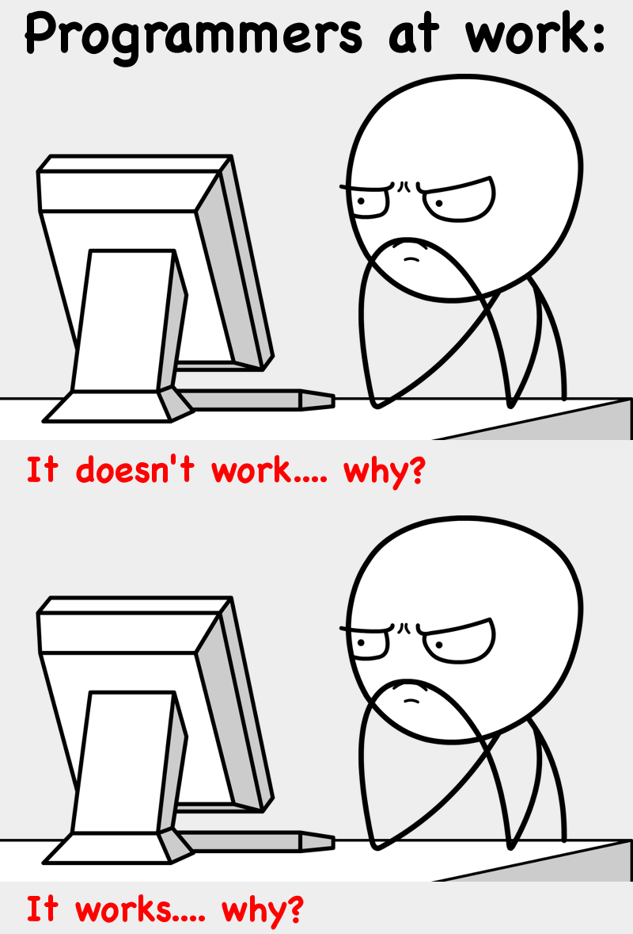
Start with Why

Slide 4
Variable & Operators
https://docs.python.org/3/tutorial/index.html
Chapter 2 of the main textbook
print()
variable
type()
string
operators
comments
input()

Slide 5
Control Statement
if
elif / else
for
range()
while
break / continue
pass

Slide 6


Slide 7

Toastmasters
Toastmasters International Mission We empower individuals to become more effective communicators and leaders.
Toastmasters Club Mission We provide a supportive and positive learning experience in which members are empowered to develop communication and leadership skills, resulting in greater self-confidence and personal growth.

Slide 8
Hands On Labs
Chapter 3. Labs of the main textbook
Chapter 3. exercise quizzes posted by Tutors
https://wikidocs.net/42527

Slide 9


Slide 10
2022 spring semester mid-term & final exam
섭씨온도(Celsius)를 화씨온도(Fahrenheit)로 변환하는 식은 아래와 같다. Fahrenheit = (9/5) * Celsius + 32 이 식을 바탕으로 섭씨온도를 0도에서 50도까지 5도 단위로 증가시키면서 이에 해당하는 화씨온도를 계산하여, 섭씨온도와 화씨온도의 값을 보여주는 프로그램을 작성하시오.
아래의 실행 결과를 적으세요. >>> a = 2*2//2 >>> b = 3//2*3 >>> print(a,b)
10 미만의 자연수에서 3과 5의 배수를 구하면 3, 5, 6, 9이다. 이들의 총합은 23이다. 1000 미만의 자연수에서 3의 배수와 5의 배수의 총합을 구하시오.

Slide 11
Tips for writing professional emails
Display name
Mail footer
Paragraphs

Slide 12
English study
https://englishcube.net/
https://www.voakorea.com/a/pops-viva-la-vida-129257083/1275747.html
If you want to share your own way to study English, don’t hesitate to share it with the colleagues and me as well.

Slide 13


Slide 14
Assignment #3
Upload HOL results on your GitHub account, and then send the GitHub link to me via email.
Choose and solve “at least” 5 questions from Chap. 3 Exercise; Write the codes with MarkDown; Upload them on your GitHub account; Send the GitHub link to me via email.
Solve the three quizzes from 2022 spring semester mid-term & final exam; Upload them on your GitHub account; Send the GitHub link to me via email.

Slide 15
Announcement #1
A special seminar is being prepared.
Topic : Open Source S/W & community
Date : Sept. 29th Thursday
Time : 4:30pm ~ 6:00pm
Lecturer : Tommy Lee
Subject to change upon the lecturer’s schedule.

Slide 16
Announcement #2
2학기 글로벌SW역량강화 정기세미나
Sept. 21, 2022
Open Source S/W community의 최신 기술 트렌드
송상효 정보자원통합심의위원회 위원장
Sept. 28, 2022
2022년 이후 변화를 이끌어갈 기술 변화의 5가지 요소
정영준 Solutions Architect @ AWS Korea

Slide 17
Further Studies
Familiarize yourself with python.org
https://wiki.python.org/moin/BeginnersGuide
Subscribe to Python newsletters
https://wiki.python.org/moin/PythonPeriodicals
Watch a movie
The Internet's Own Boy: The Story of Aaron Swartz

Slide 18
Books for the aggressive students
3rd week: 스타트 위드 와이
2nd week: 오픈 소스로 미래를 연마하라
1st week: 히트 리프레시

Slide 19
For those who didn’t attend the 1st & 2nd lecture.
Fill out the survey; You can find the link at LMS Announcement https://forms.gle/sQApQRegFV6y7ysH7
Fill out the PowerPoint file to tell me who you are; You can find the template file at LMS Repository; Send it to me via email.
Please refer to Toastmasters slide of the visual aids from the first lecture if you want extra points at Attitude criteria.
Please feel free to contact me during the break if you have any questions.

Slide 20
“Genius has no race. Strength has no gender. Courage has no limit.”
– Hidden Figures

